Slide 1
CS 3006 Parallel and Distributed Computing Lecture 13
Danyal Farhat
FAST School of Computing
NUCES Lahore

Slide 2
Basic Communication Operations

Slide 3
Outline
Basic Communication Operations
Preliminaries
Assumptions for the Operations
One-to-All Broadcast & All-to-One Reduction
Linear Array or Ring
Matrix-Vector Multiplication (An Application)
Mesh Broadcast and Reduction
Balanced Binary Tree
Hypercube Broadcast (3-D Structure)
Cost Estimation

Slide 4
Outline (Cont.)
All-to-All Broadcast and All-to-All Reduction
Linear Ring Broadcast
Linear Ring Reduction
All-to-All Broadcast on 2D Mesh
All-to-All Broadcast on HyperCube
Cost Estimation
Exercise
Summary
Additional Resources

Slide 5
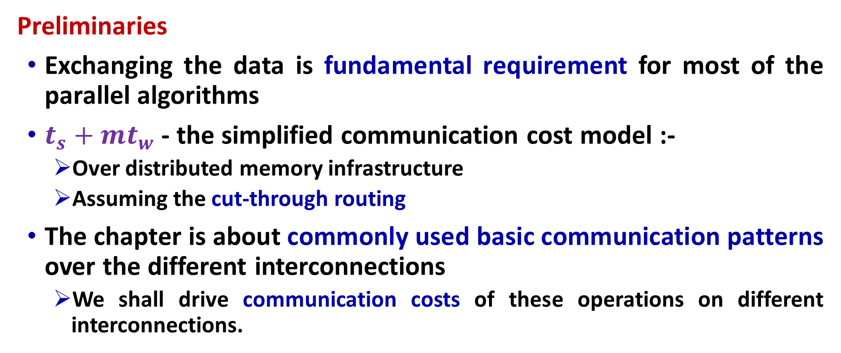
Basic Communication Operations
Preliminaries
Exchanging the data is fundamental requirement for most of the parallel algorithms
$t_{s}+mt_{w}$ - the simplified communication cost model :-
Over distributed memory infrastructure
Assuming the cut-through routing
The chapter is about commonly used basic communication patterns over the different interconnections
We shall drive communication costs of these operations on different interconnections.
Notes:
Here ts is the latency or the startup time for the data transfer and tw is the per-word transfer time, which is inversely proportional to the available bandwidth between the nodes.

Slide 6
Basic Communication Operations (Cont.)
Assumptions for the Operations
Interconnections support cut-through routing
Communication time between any pair of nodes in the network is same (regardless of the number of intermediate nodes)
Links are bi-directional
The directly connected nodes can simultaneously send messages of m words without any congestion
Single-port communication model
A node can send on only one of its links at a time
A node can receive on only one of its links at a time
However, a node can receive a message while sending another message at the same time on the same or a different link

Slide 7
Basic Communication Operations (Cont.)
One-to-All Broadcast
A single process sends identical data to all other processes
Initially one process has data of m size.
After broadcast operation, each of the processes have own copy of the m size.
All-to-One Reduction
Dual of one-to-all broadcast
The m-sized data from all processes are combined through an associative operator, accumulated at a single destination process into one buffer of size m
Applications: vector-matrix multiplication, shortest paths calculation, and inner vector product

Slide 8
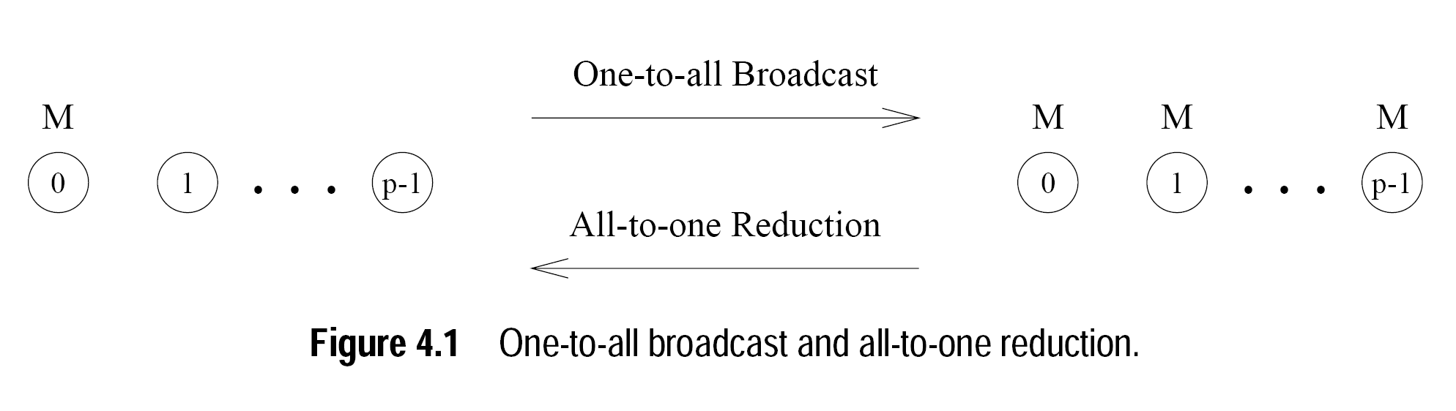
Basic Communication Operations (Cont.)

Slide 9
One-to-All Broadcast and All-to-One Reduction
Linear Array or Ring
Naïve solution
sequentially send p - 1 messages from the source to the other p - 1 processes
Bottlenecks, and underutilization of communication network
Solution?
Recursive doubling
Source process sends the massage to another process
In next communication phase both the processes can simultaneously propagate the message

Slide 10
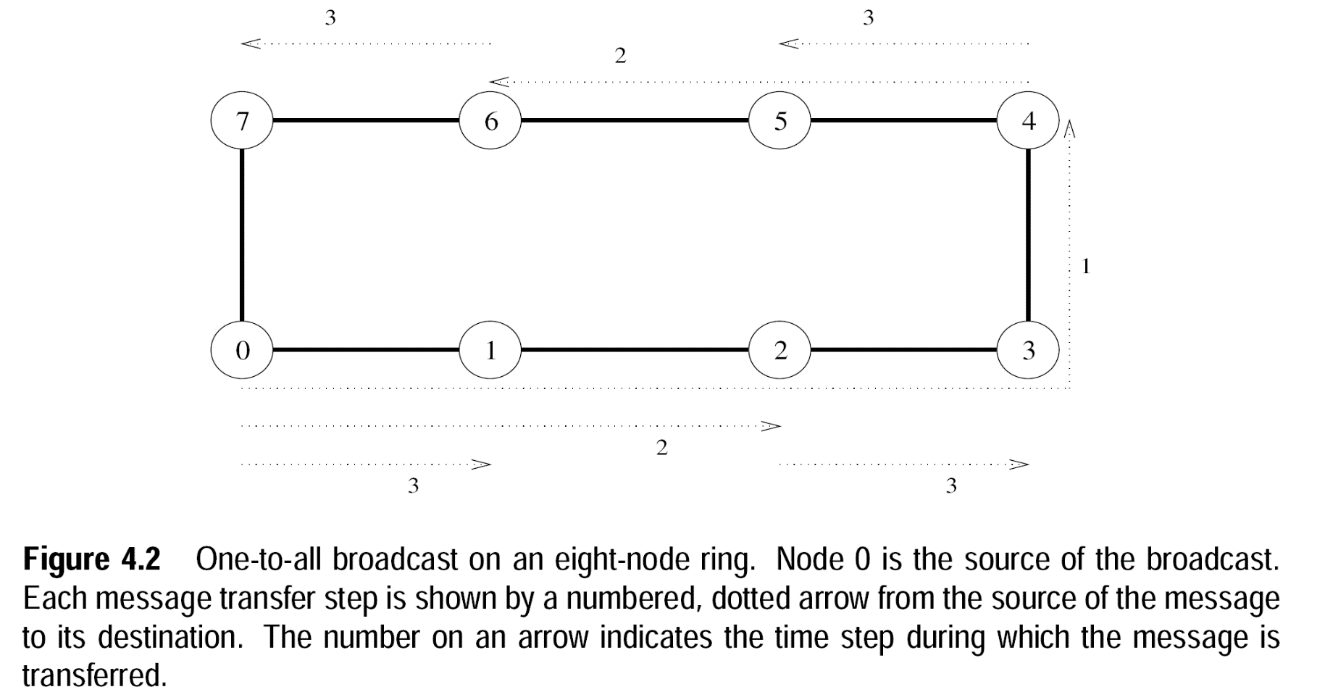
One-to-All Broadcast and All-to-One Reduction
Linear Array or Ring (One Dimensional Structure)
Recursive Doubling Broadcast
Select destination such that no congestions occur

Slide 11
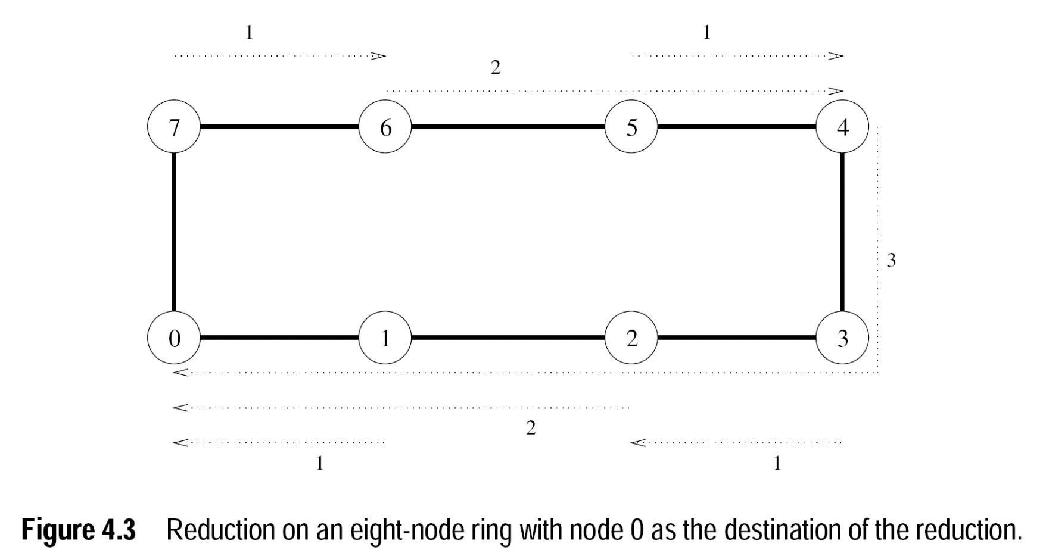
One-to-All Broadcast and All-to-One Reduction
Linear Array or Ring (One Dimensional Structure)
Recursive Doubling Reduction
Odd will send message to even and associative operator will combine the results

Slide 12
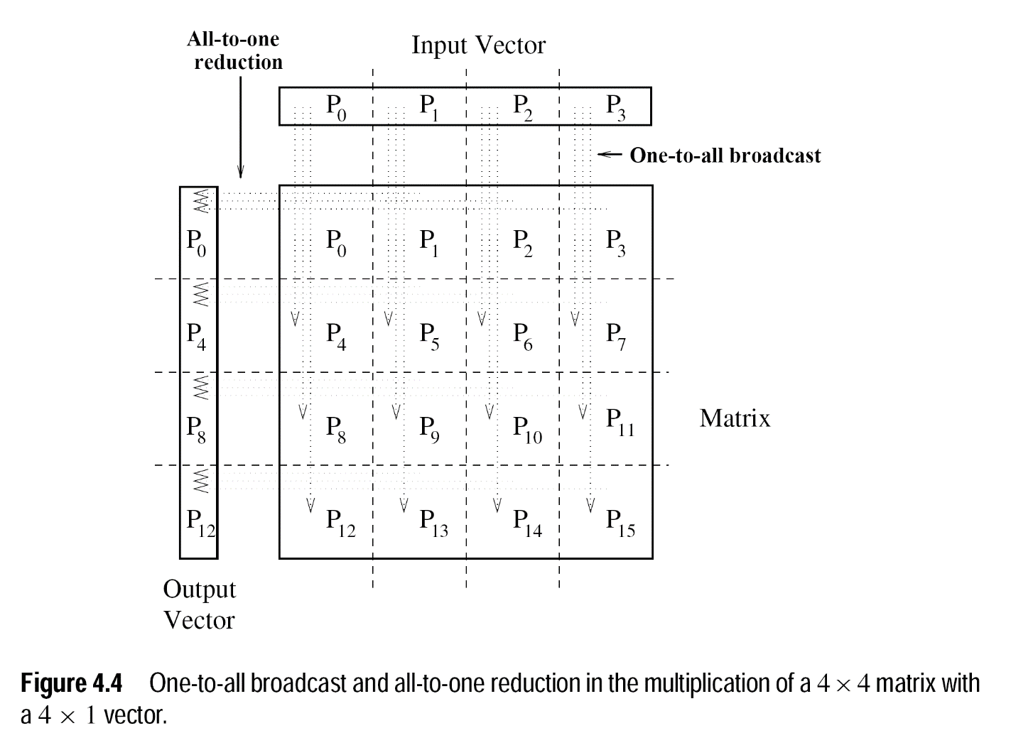
Matrix-Vector Multiplication (An Application)

Slide 13
Mesh Broadcast and Reduction
We can regard each row and column of a square mesh of p nodes as a linear array of nodes
Communication algorithms on the mesh are simple extensions of their linear array counterparts
Broadcast and Reduction
Two step breakdown:
The operation is performed along one by treating the row as linear array
Then the all the columns are treated similarly

Slide 14
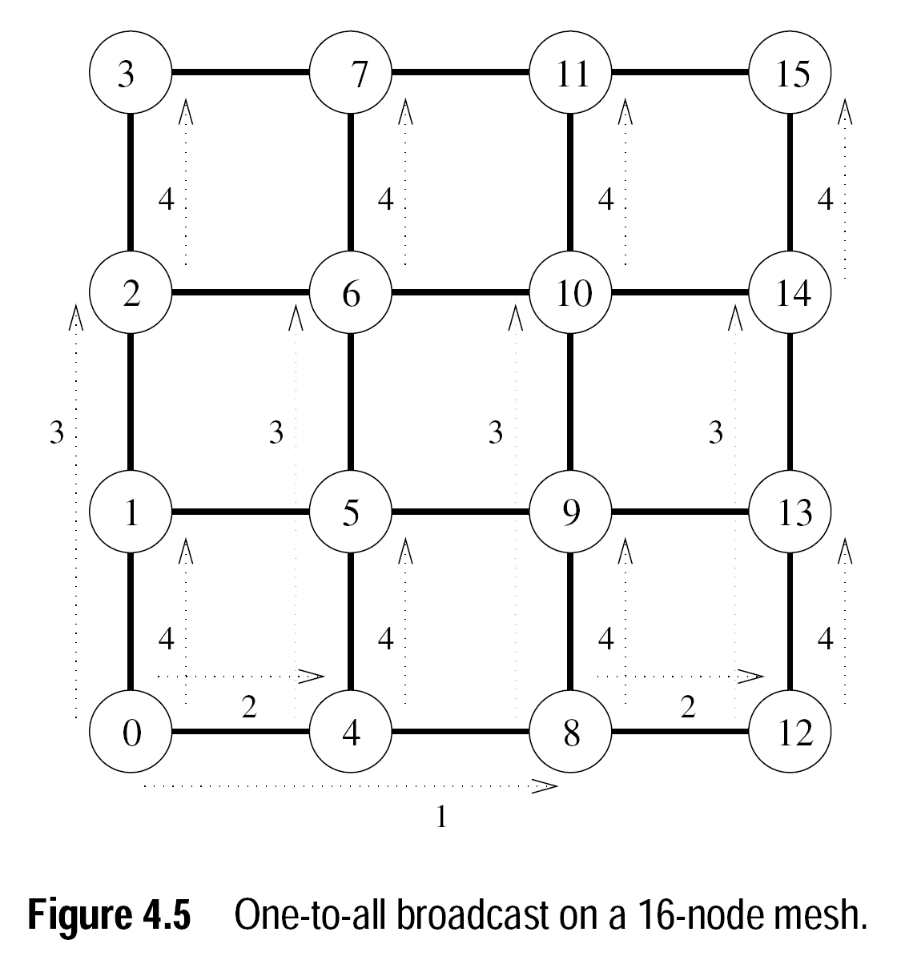
Mesh Broadcast and Reduction (Cont.)

Slide 15
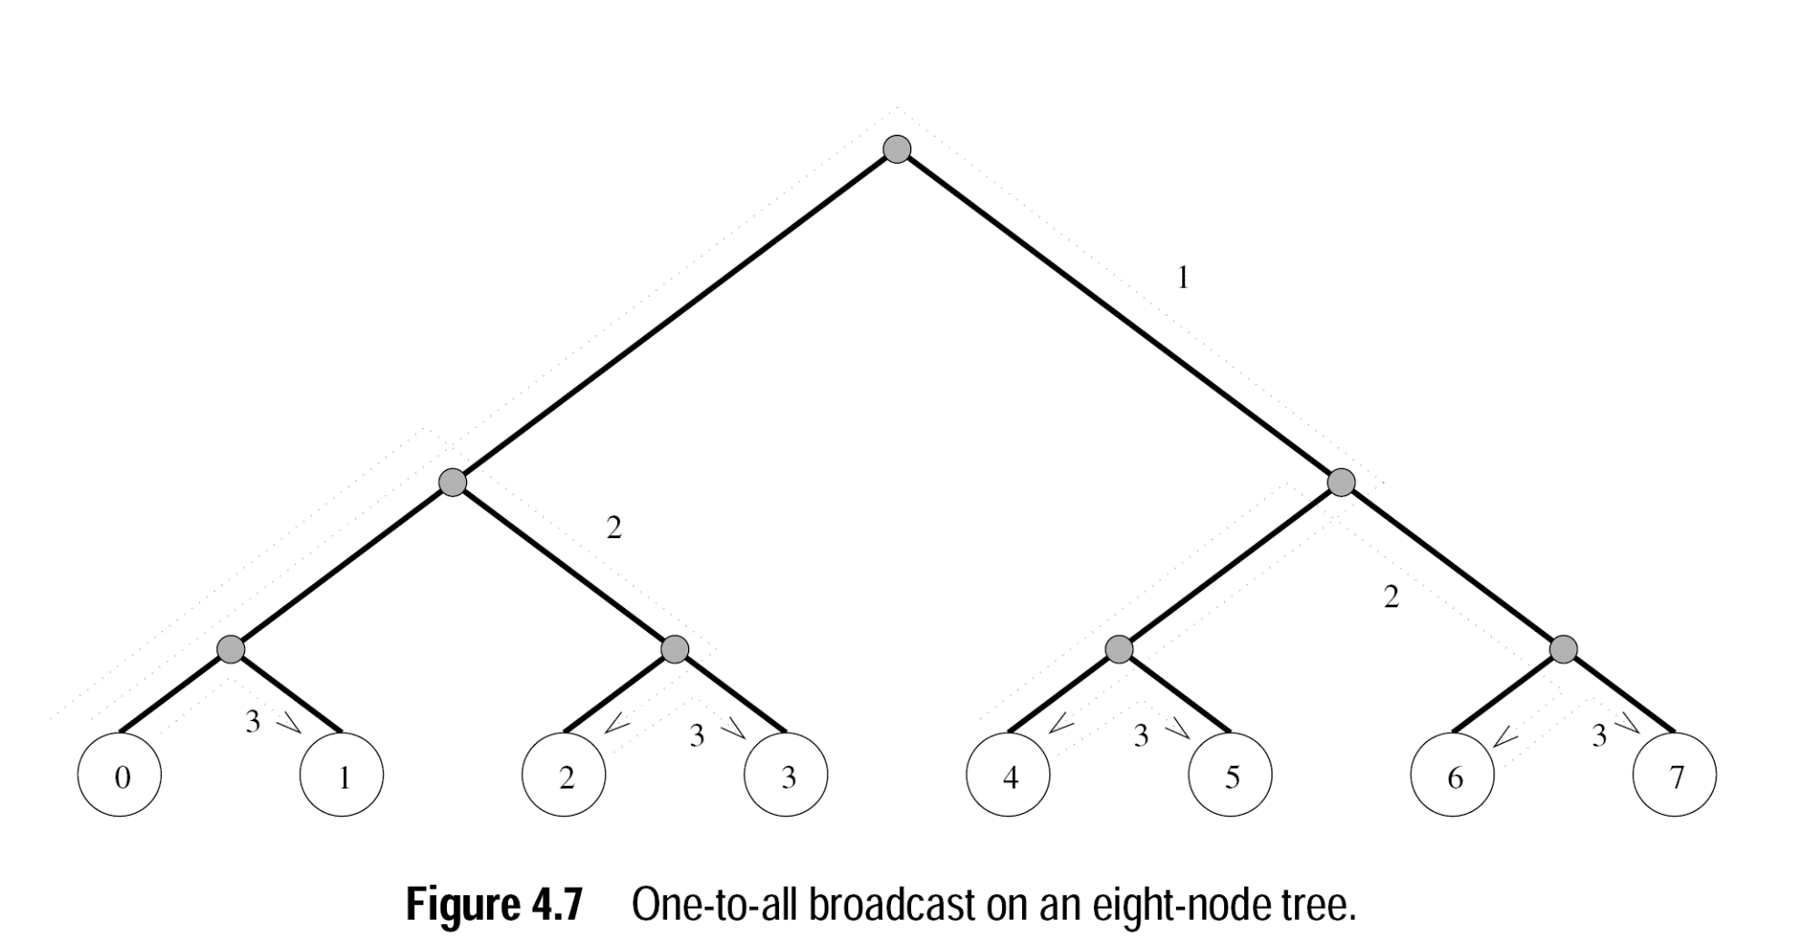
Balanced Binary Tree
Broadcast

Slide 16
Hypercube Broadcast (3-D Structure)
Source node first send data to one node in the highest dimension
The communication successively proceeds along lower dimensions in the subsequent steps
The algorithm is same as used for linear array
But, here changing order of dimension does not congest the network
i.e. can move from x-axis to z-axis or from z-axis to x-axis

Slide 17
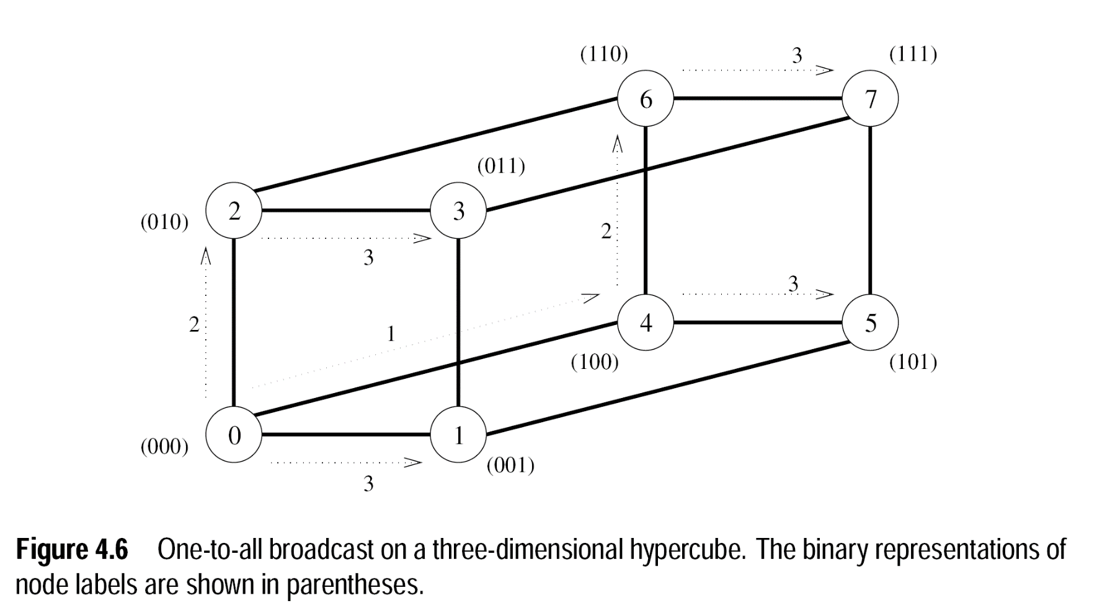
Hypercube Broadcast (Cont.)
Communication done along z-axis, then y-axis, and then x-axis

Slide 18
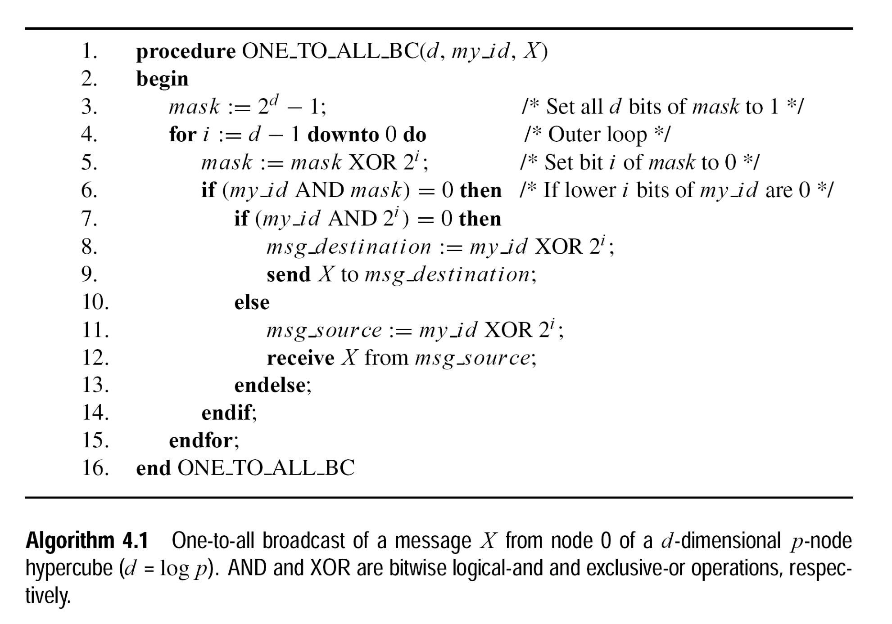
Hypercube Broadcast (Cont.)
Notes:
6) id AND mask==0 → if I will be in communication in this step (if my i bits are zero)
7) Id AND 2i ==0 → if I’m the sender of message (if my i+1th bit is 0)
8) Xoring id with 2i gives my partner in ith phase of the algorithm

Slide 19
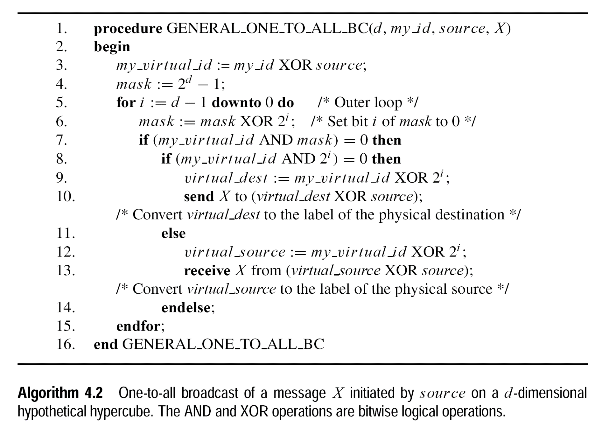
Hypercube Broadcast General
Notes:
source XOR source makes source→ zero and similarly maps other according to the source

Slide 20
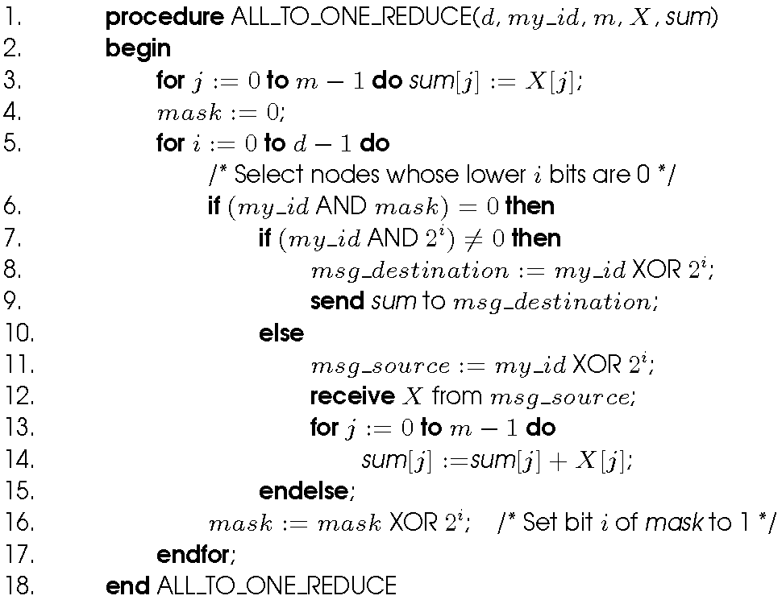
Hypercube Reduction
Assigned Reading

Slide 21
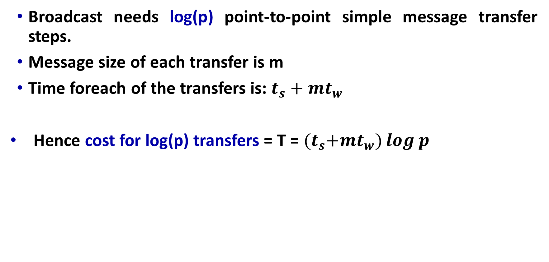
Cost Estimation
Broadcast needs log(p) point-to-point simple message transfer steps.
Message size of each transfer is m
Time foreach of the transfers is: $t_{s}+mt_{w}$
Hence cost for log(p) transfers = T = ${(t}_{s}+mt_{w})\log{p}$

Slide 22
All-to-All Broadcast and All-to-All Reduction
All-to-All Broadcast
A generalization to one-to-all broadcast
Every process broadcasts m-word message
The broadcast-message for each of the processes can be different than others
All-to-All Reduction
Dual of all-to-all broadcast
Each node is the destination of an all-to-one reduction out of total P reductions
Applications in different matrix operations including matrix multiplication and matrix-vector multiplication

Slide 23
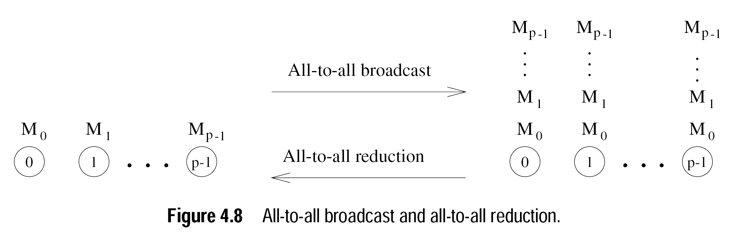
All-to-All Broadcast and All-to-All Reduction (Cont.)
A naïve Broadcast method may be performing P one-to-all broadcasts. This will result P( log(p)(t(s) + mt(w)) ) communication time.

Slide 24
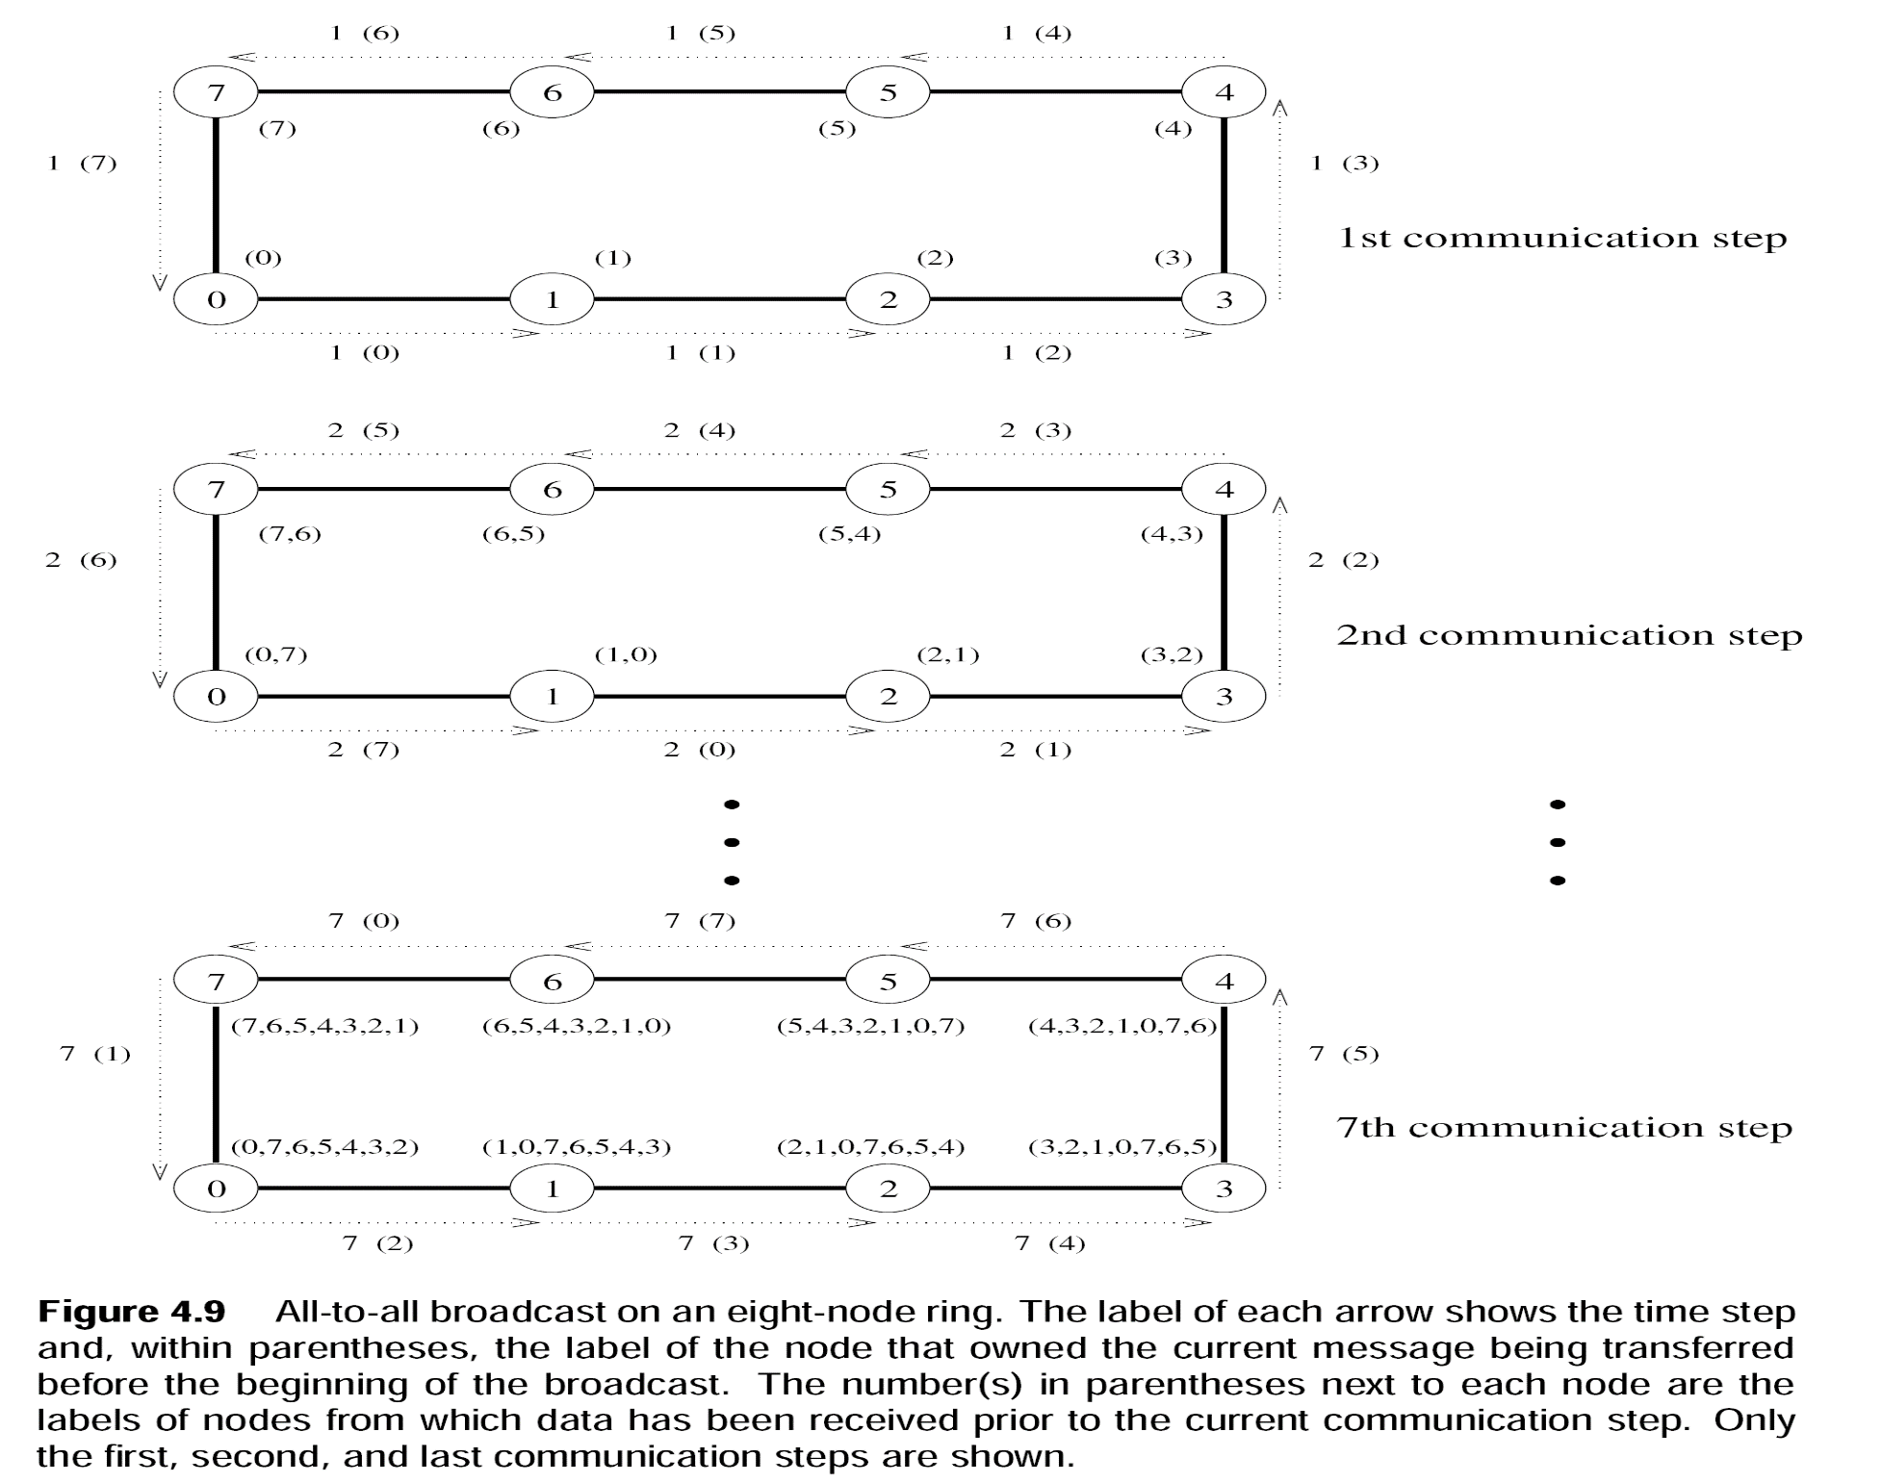
All-to-All Broadcast and All-to-All Reduction (Cont.)

Slide 25
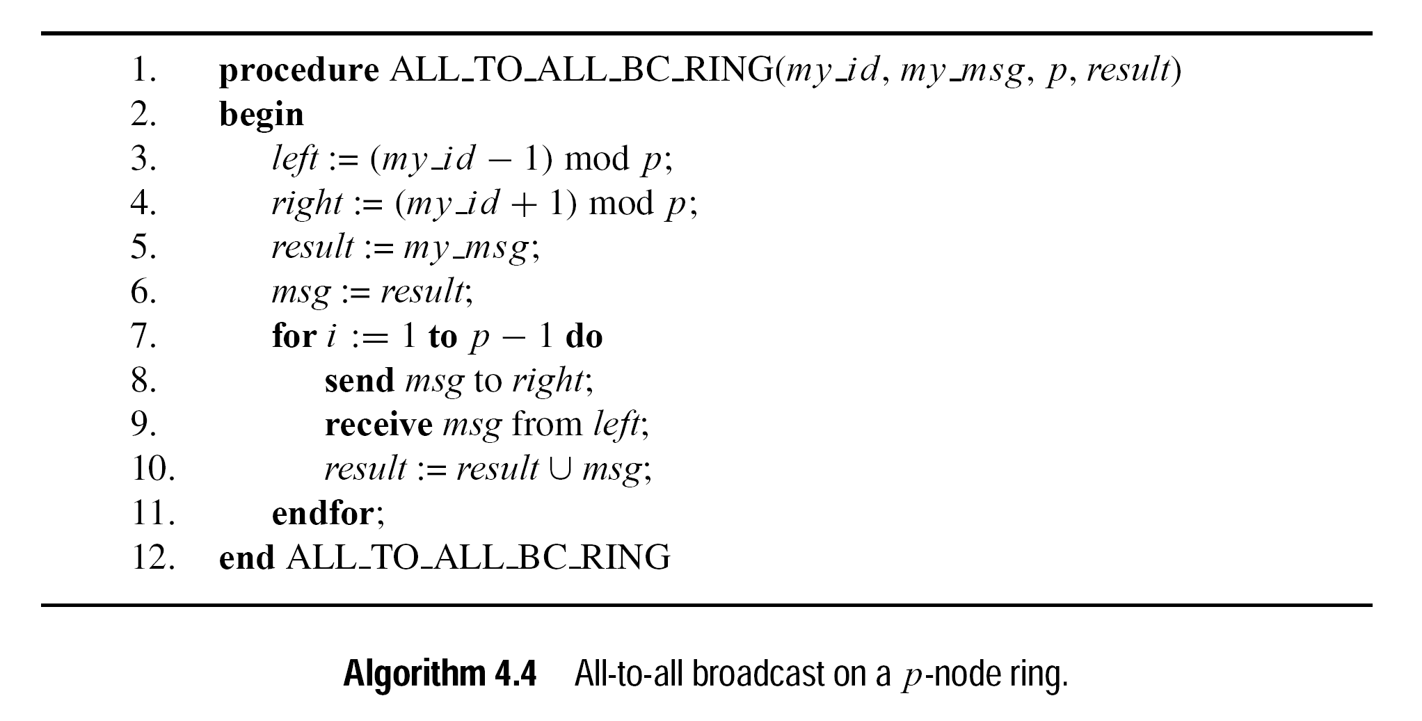
Linear Ring Broadcast

Slide 26
All-to-All Reduction
Linear Array or Ring
Reduction
Draw an All-to-All Broadcast on a P-node linear ring
Reverse the directions in each foreach of the step without changing message
After each communication step, combine messages having same broadcast destination with associative operator
Now, Its your turn to draw?
Draw an All-to-All Broadcast on a 4-node linear ring
Reverse the directions and combine the results using ‘SUM’

Slide 27
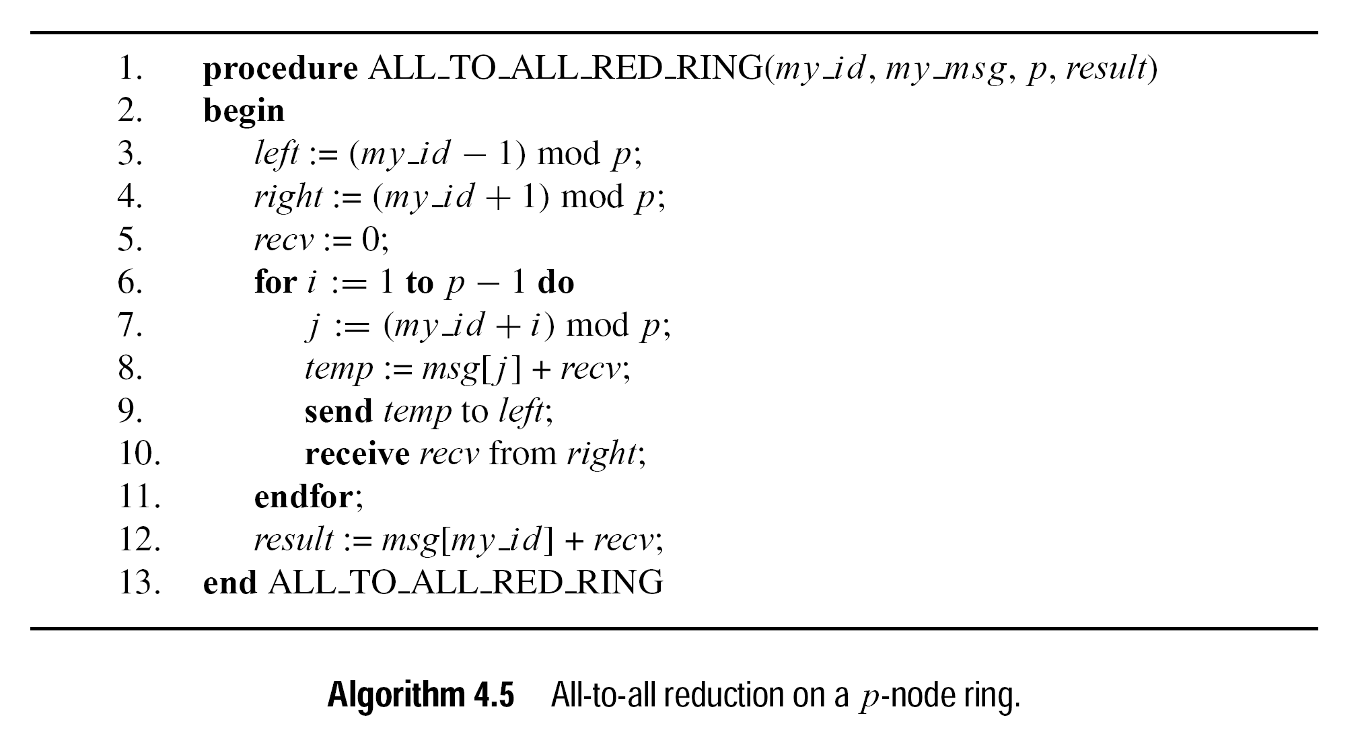
Linear Ring Reduction

Slide 28
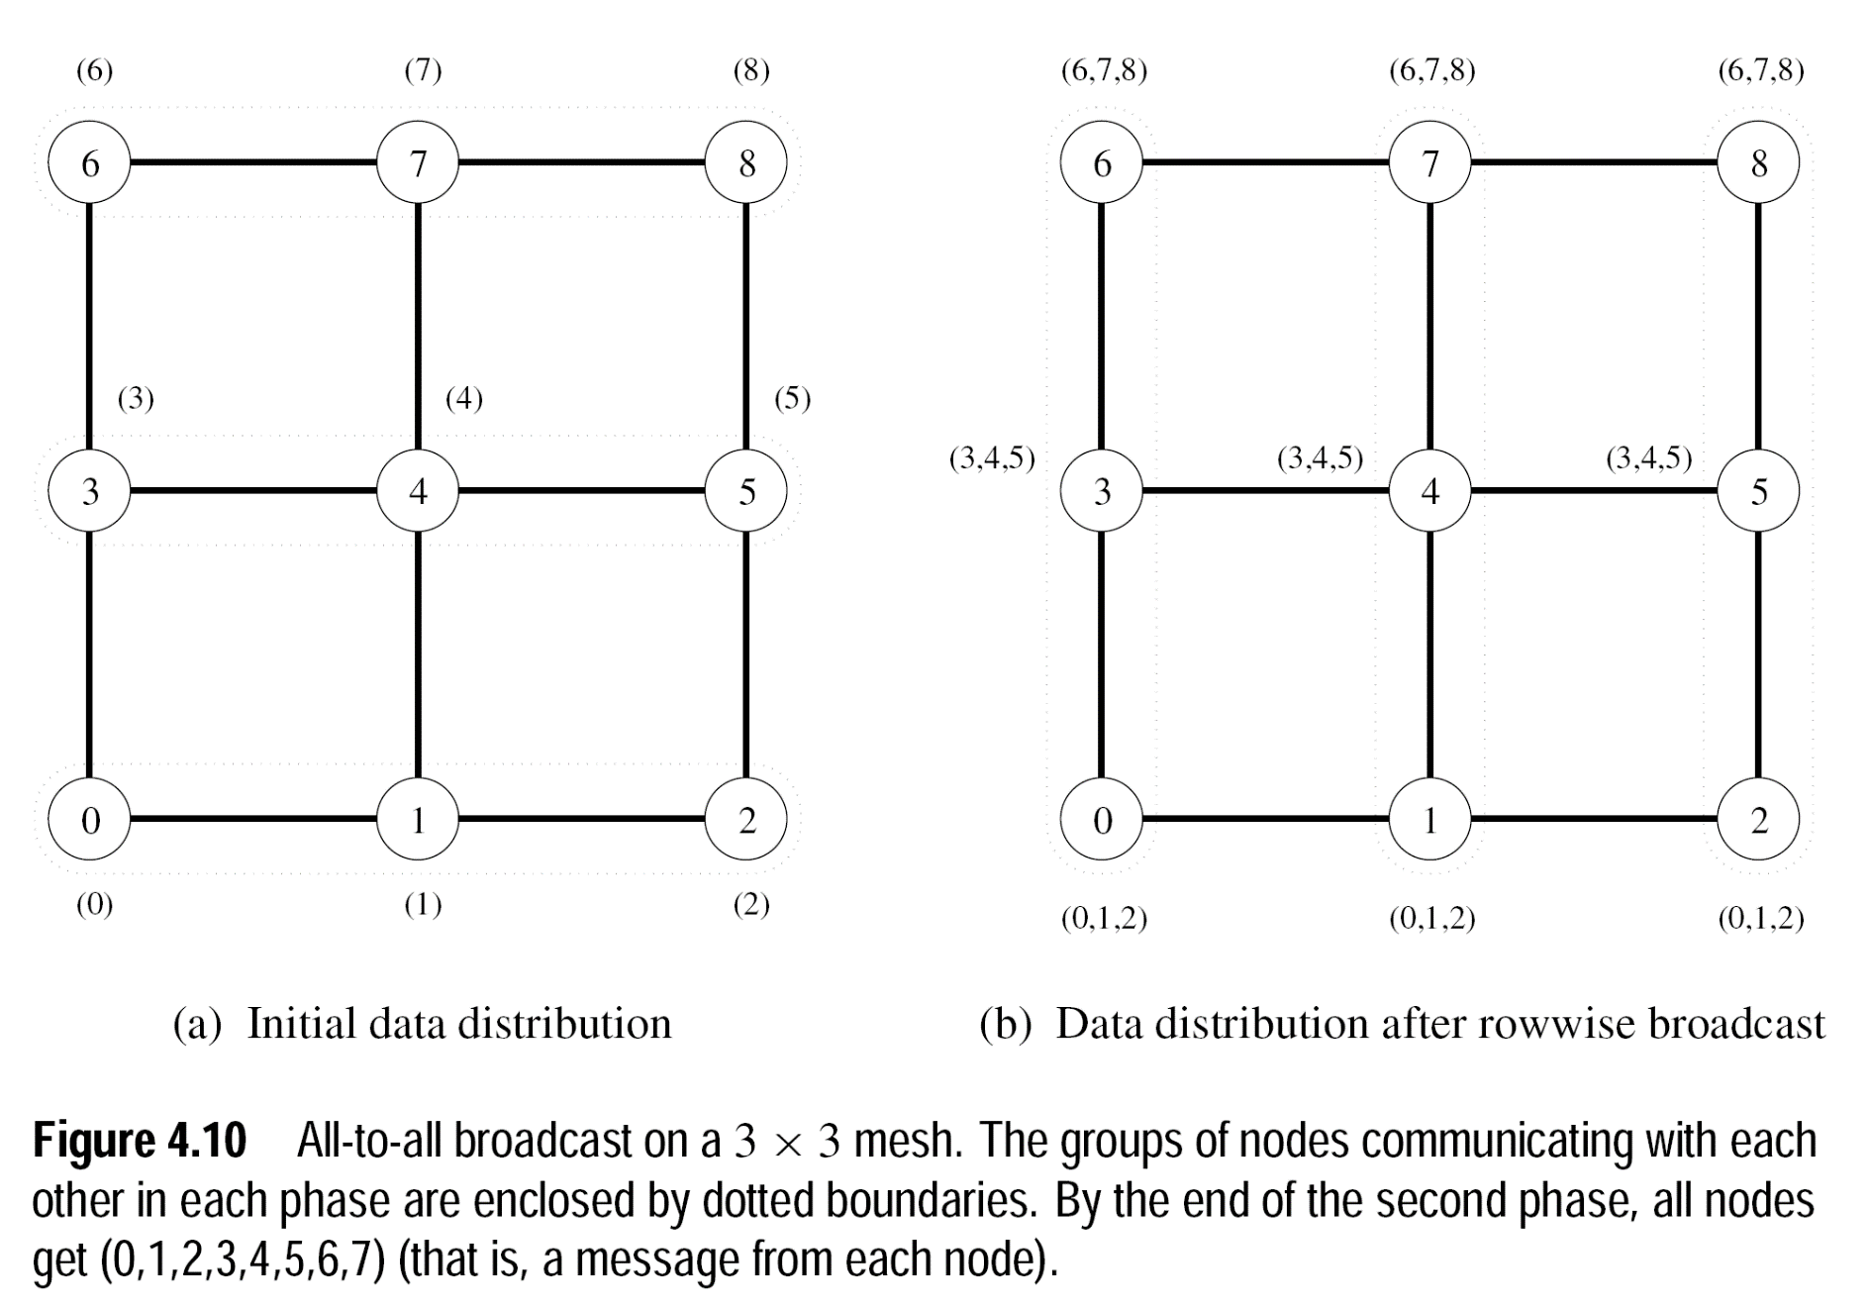
All-to-All Broadcast on 2D Mesh

Slide 29
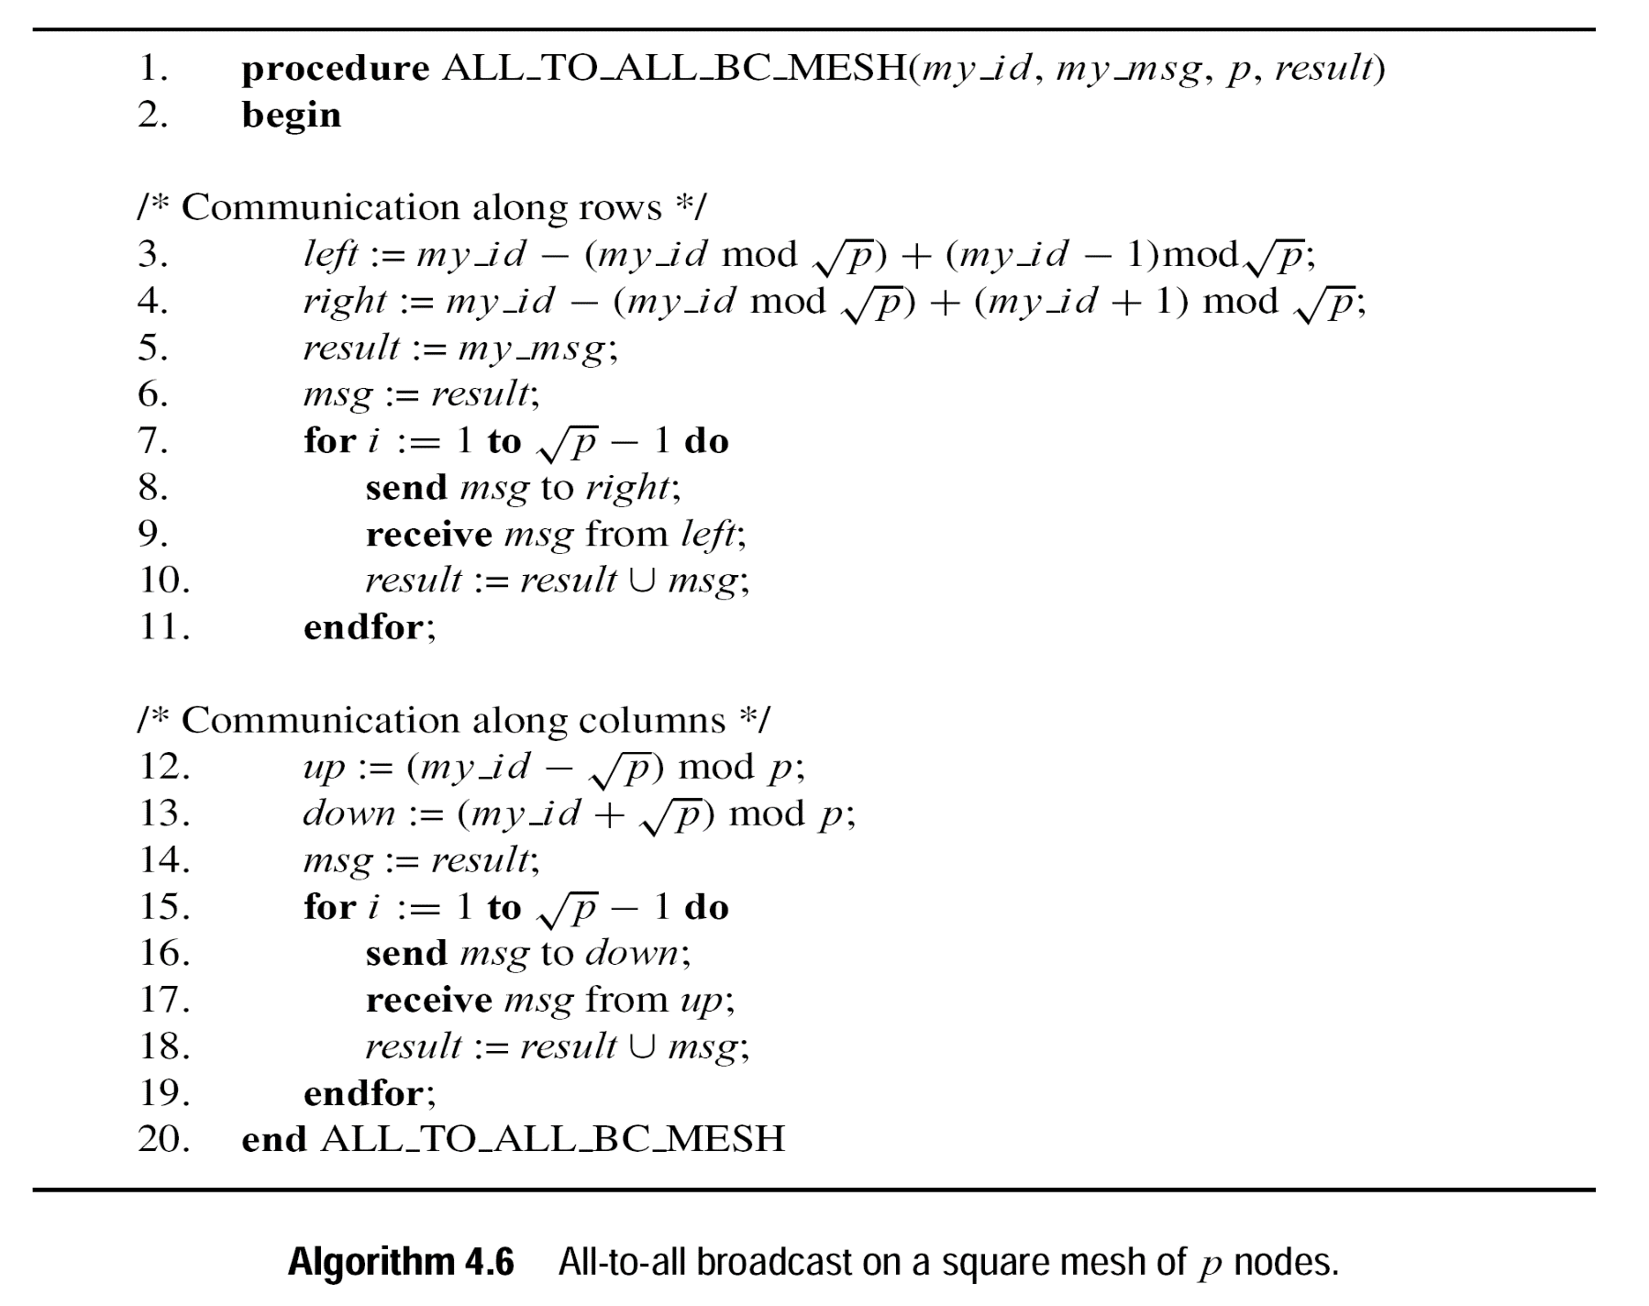
All-to-All Broadcast on 2D Mesh Algorithm

Slide 30
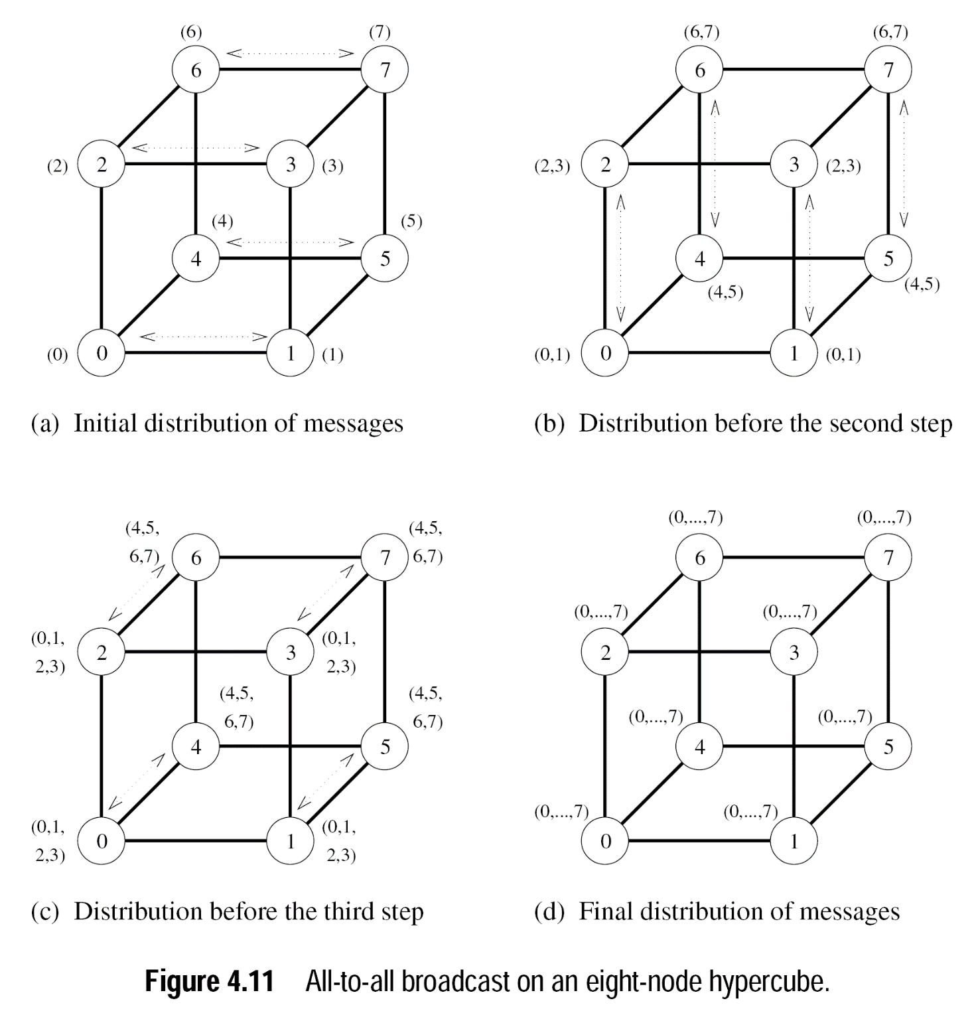
All-to-All Broadcast on HyperCube
Along x-axis then y-axis then z-axis

Slide 31
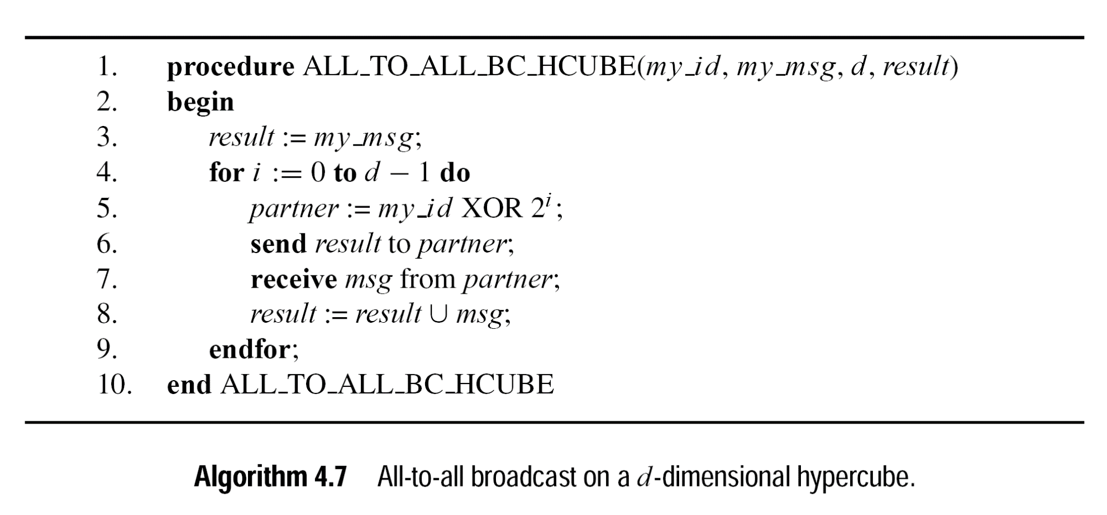
All-to-All Broadcast on HyperCube..Algorithm

Slide 32
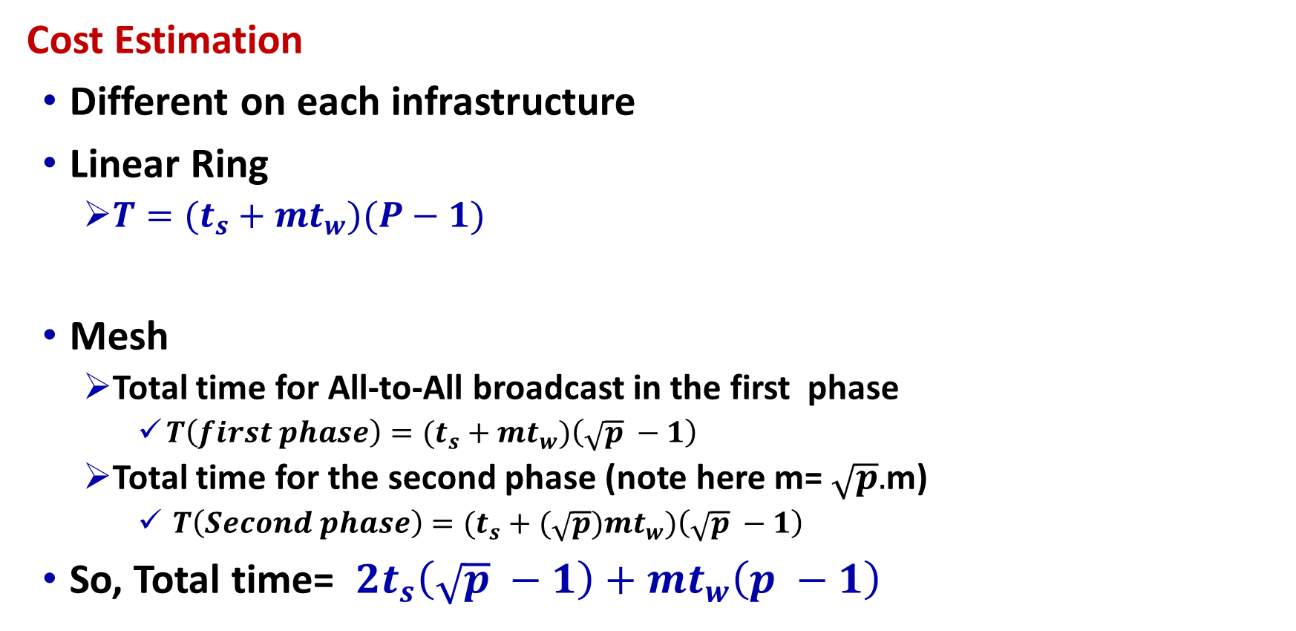
All-to-All Broadcast and All-to-All Reduction
Cost Estimation
Different on each infrastructure
Linear Ring
${T=(t}_{s}+mt_{w})(P−1)$
Mesh
Total time for All-to-All broadcast in the first phase
${T\left(first phase\right)=(t}_{s}+mt_{w})\left(\sqrt{p} −1\right)$
Total time for the second phase (note here m= $\sqrt{p}.$m)
${T\left(Second phase\right)=(t}_{s}+(\sqrt{p})mt_{w})\left(\sqrt{p} −1\right)$
So, Total time= ${ 2t}_{s}\left(\sqrt{p} −1\right)+mt_{w}\left(p −1\right)$

Slide 33
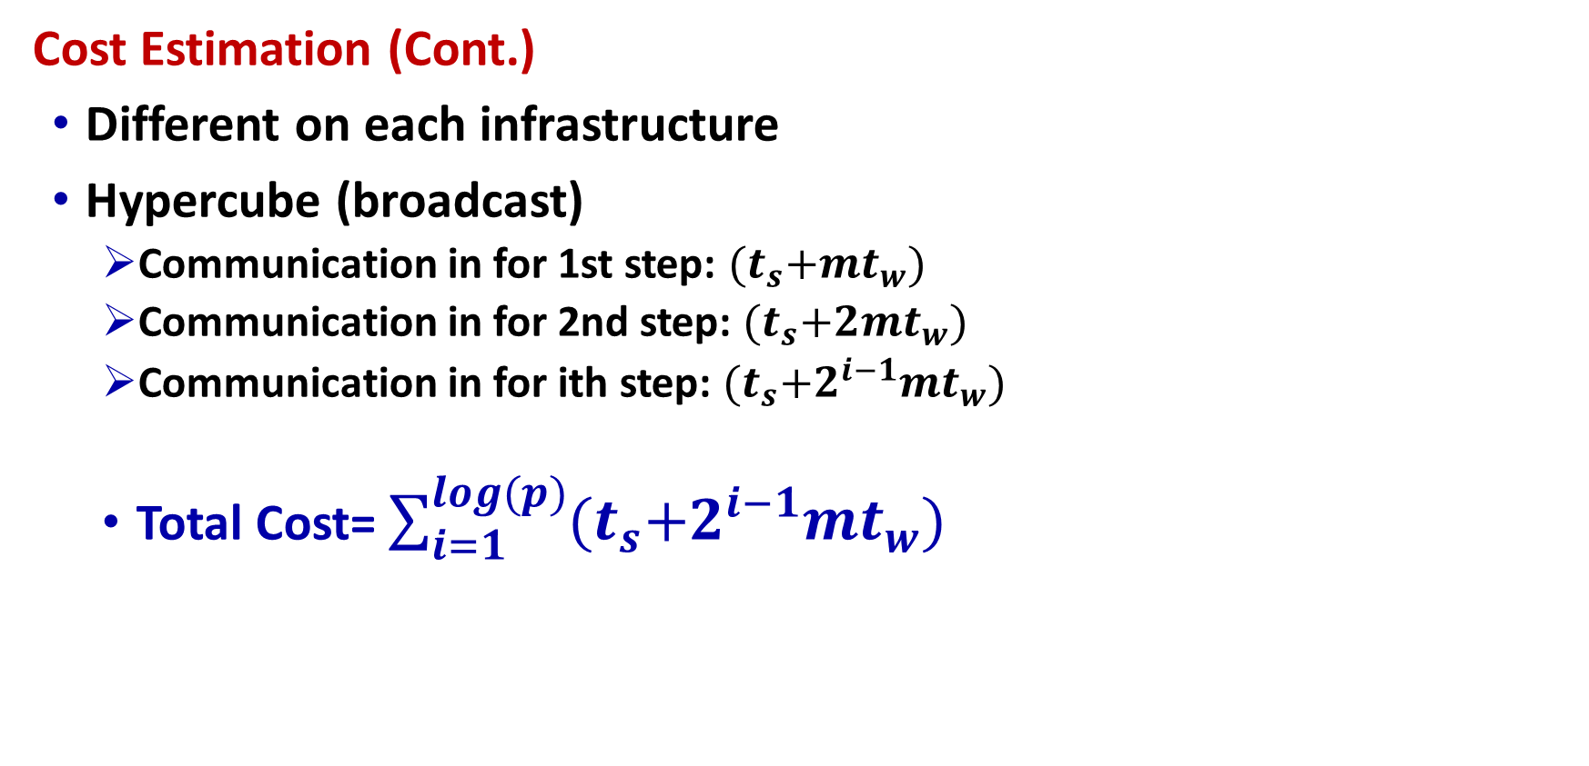
All-to-All Broadcast and All-to-All Reduction (Cont.)
Cost Estimation (Cont.)
Different on each infrastructure
Hypercube (broadcast)
Communication in for 1st step: ${(t}_{s}+mt_{w})$
Communication in for 2nd step: ${(t}_{s}+2mt_{w})$
Communication in for ith step: ${(t}_{s}+2^{i−1}mt_{w})$
Total Cost= $\sum_{i=1}^{log⁡(p)}{{(t}_{s}+2^{i−1}mt_{w})}$

Slide 34
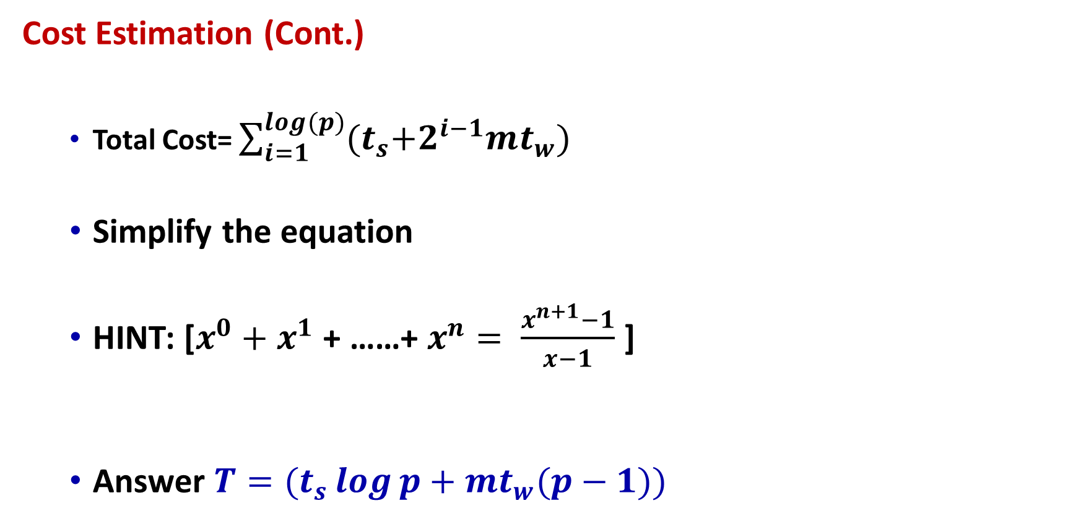
All-to-All Broadcast and All-to-All Reduction (Cont.)
Cost Estimation (Cont.)
Total Cost= $\sum_{i=1}^{log⁡(p)}{{(t}_{s}+2^{i−1}mt_{w})}$
Simplify the equation
HINT: [$x^{0}+$ $x^{1}$ + ……+ $x^{n}= \frac{x^{n+1}−1}{x−1}$ ]
Answer ${T=(t}_{s}\log{p}+mt_{w}(p−1))$

Slide 35
Exercise
Dry run one-to-all broadcast and all-to-one reduction on 16 nodes ring structure.

Slide 36
Summary
Basic Communication Operations
Preliminaries
Exchanging the data is fundamental requirement for most of the parallel algorithms
Assumptions for the Operations
Interconnections support cut-through routing
Communication time between any pair of nodes in the network is same
Links are bi-directional
Single-port communication model

Slide 37
Summary (Cont.)
One-to-All Broadcast & All-to-One Reduction
One-to-All Broadcast - A single process sends identical data to all other processes
All-to-One Reduction - The m-sized data from all processes are combined through an associative operator, accumulated at a single destination process into one buffer of size m
Linear Array or Ring
Matrix-Vector Multiplication (An Application)
Mesh Broadcast and Reduction
Balanced Binary Tree
Hypercube Broadcast (3-D Structure)
Cost Estimation

Slide 38
Summary (Cont.)
All-to-All Broadcast and All-to-All Reduction
All-to-All Broadcast - Every process broadcasts m-word message
All-to-All Reduction - Each node is the destination of an all-to-one reduction out of total P reductions
Linear Ring Broadcast
Linear Ring Reduction
All-to-All Broadcast on 2D Mesh
All-to-All Broadcast on HyperCube
Cost Estimation
Exercise

Slide 39
Additional Resources
Introduction to Parallel Computing by Ananth Grama and Anshul Gupta
Chapter 4: Basic Communication Operations

Slide 40
Questions?

